Slide 1
Results Page
Arun Ragavendhar
104837257

Slide 2
Overview of my Technical and management Contributions
Designed and developed the files required to implement the results page. Namely :
Results.html – to display the results data to the user.
Results.css – to style the results.html page to offer an immersive and enhanced user experience.
Results.js – to make the page interactive
Results.php – to connect to the database, exchange data and to calculate user score and other details.
Created the Scores Table in the database.
Made important and significant technical contributions to the overall project design and development.
Co-ordinated, arranged and contributed to the group team management for all activities like group meetings, brainstorming sessions as well as project related research activities.

Slide 3
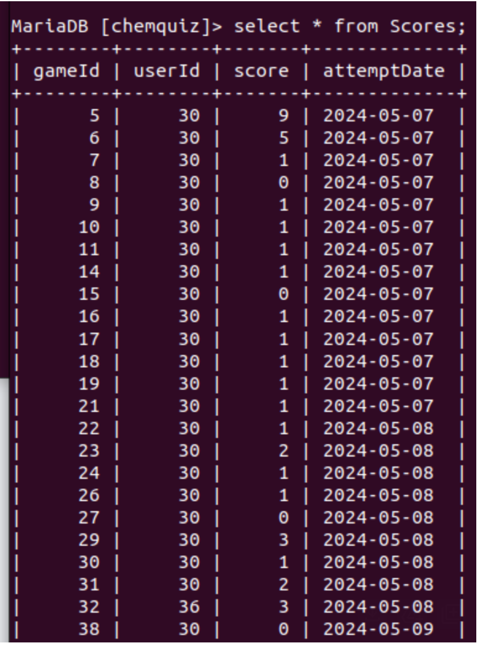
Technical Contributions and Functionalities Implemented
Creation of the database and Scores Table
A ‘Chem Quiz’ database is created for user data storage , retrieval and modification.
A cores table has been created within this database to score the game attempt details of a specific user.
It has the following attributes
gameID – primary key
UserId – foreign key
Score
attemptDate

Slide 4
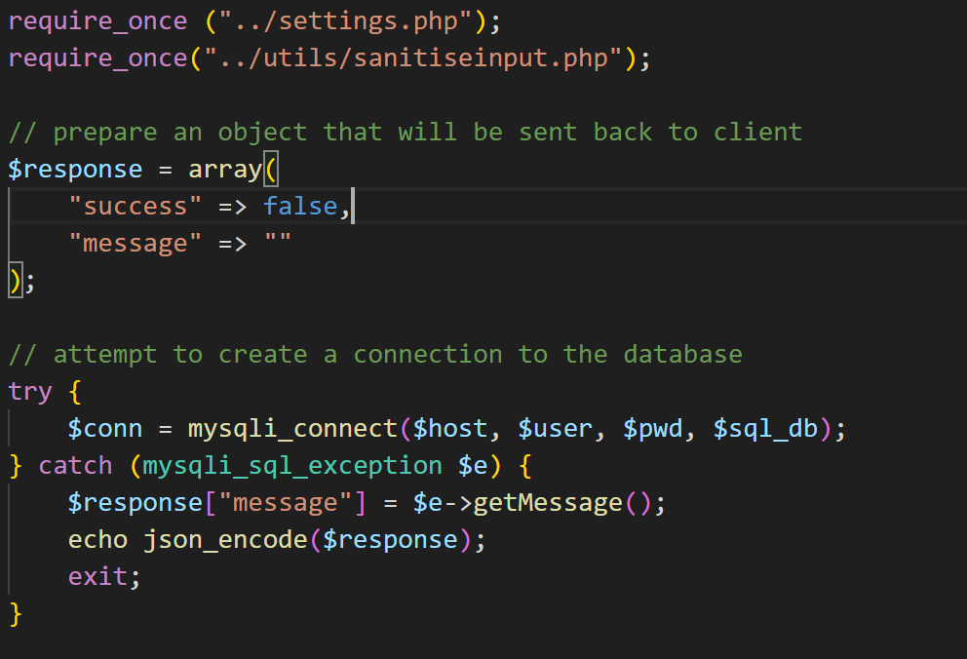
Technical Contributions and Functionalities Implemented
Connection to the database
The Results.php file first connects to the database to send , store and retrieve data.
It uses the host address, username , password and database name to the make the connection to the database.

Slide 5
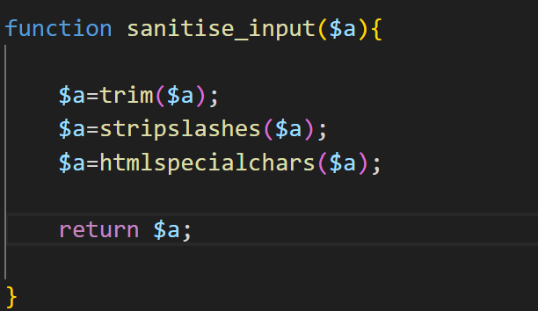
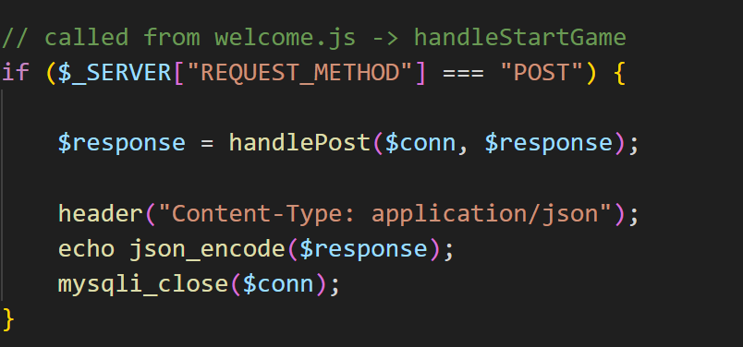
Technical Contributions and Functionalities Implemented
Input Sanitization for Security and check for Request Method
Sanitizes the input date for security purpose before using it in an SQL query to prevent SQL injection attacks.
It also checks for the server request method to ensure that the use cannot sneak in by entering the file name in the URL.

Slide 6
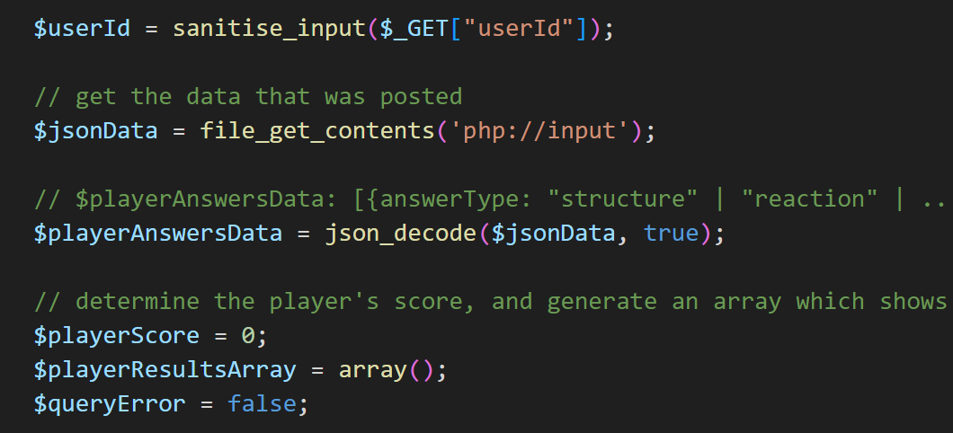
Technical Contributions and Functionalities Implemented
Getting the Player Answers from Questions .js
The results.php file gets the player answer , the question Id and the question type for each question form the questions. Js file as JSON encoded data.
The results.php file decodes this JSON data and now has the questions as an array of objects.

Slide 7
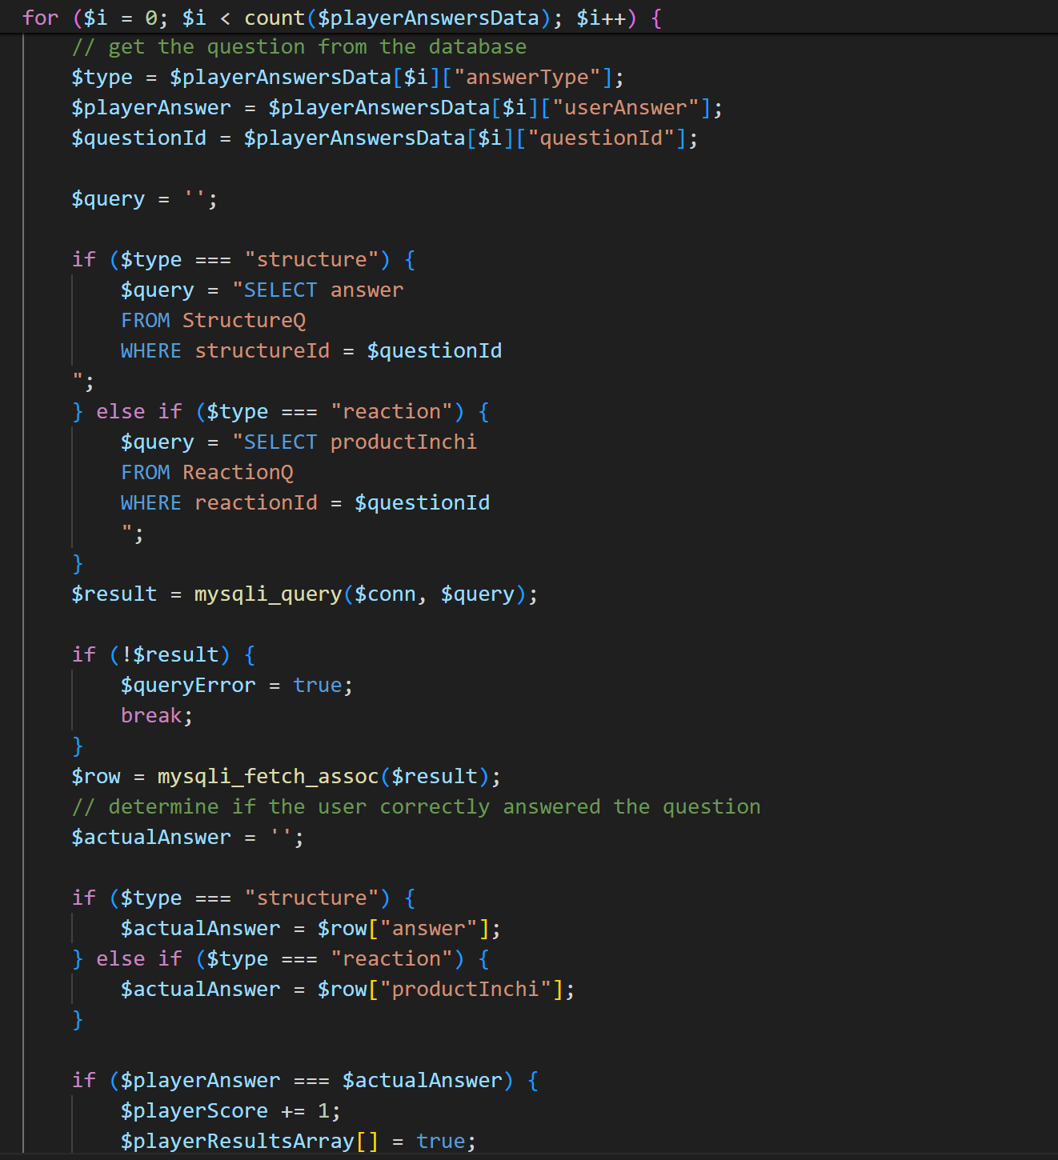
Technical Contributions and Functionalities Implemented
Calculation of the User Score
A for loop is run to extract the correct answer for each question based on the ‘question Id’ and the ‘question type’.
If the ‘user answer’ is the same as the ‘correct answer , the player score is increased.
After the end of the loop , the user score is calculated.

Slide 8
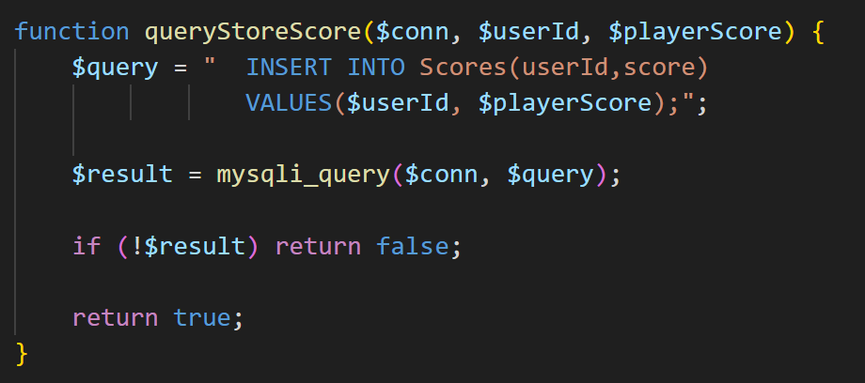
Technical Contributions and Functionalities Implemented
Updating User Scores to the Scores table
The calculated user score is updated to the Scores table by using an INSERT query to the Scores Table

Slide 9
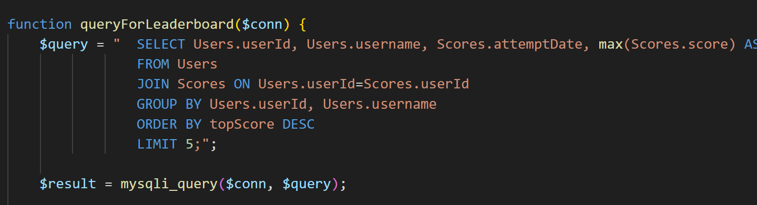
Technical Contributions and Functionalities Implemented
Functions and queries to extract the leaderboard Details
A SELECT query using JOIN and GROUP BY is used extract the TOP 5 performing students and their highest scores.

Slide 10
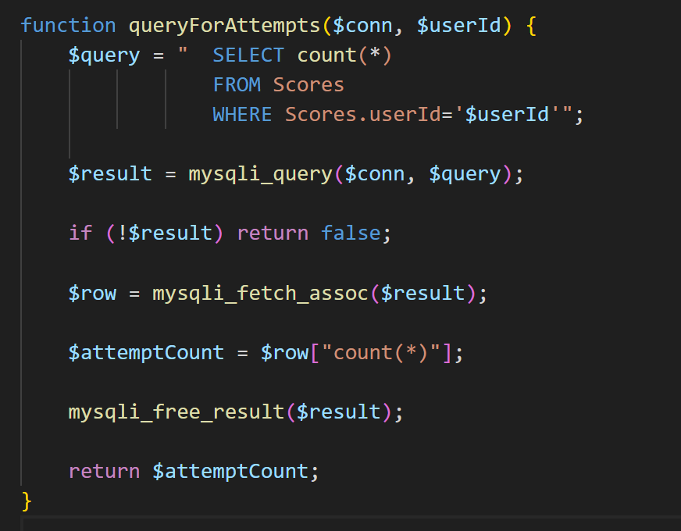
Technical Contributions and Functionalities Implemented
Functions and queries to extract number of game attempts
A SELECT query with a count(*) is used to extract the number of attempts the specific user has played the quiz .

Slide 11
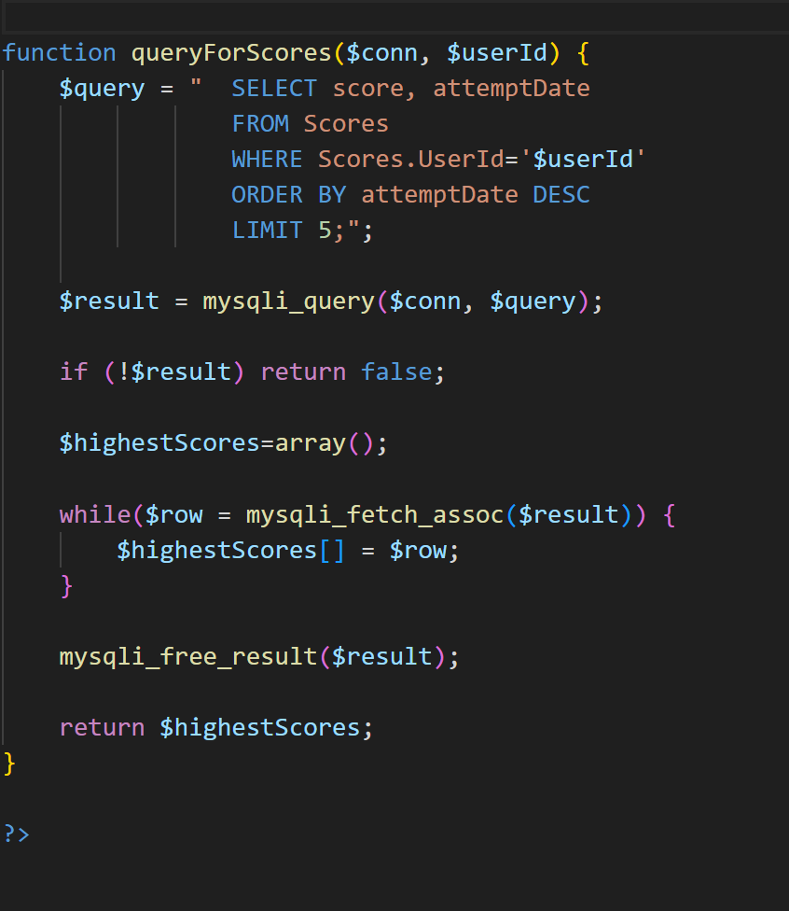
Technical Contributions and Functionalities Implemented
Functions and queries to extract the results of the 5 most recent attempts of the student
A SELECT query with an ORDER BY and LIMIT is used to extract the 5 most recent results of the student arranged by date of latest attempt

Slide 12
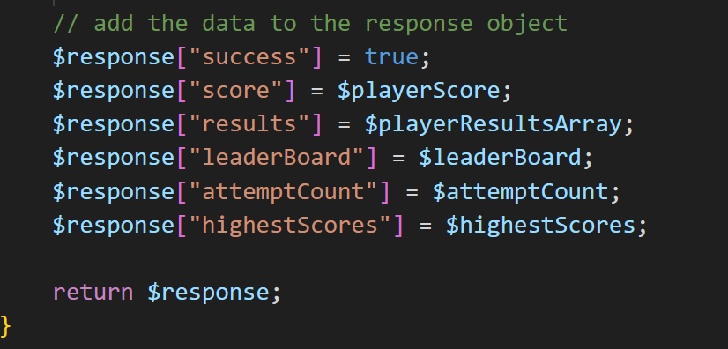
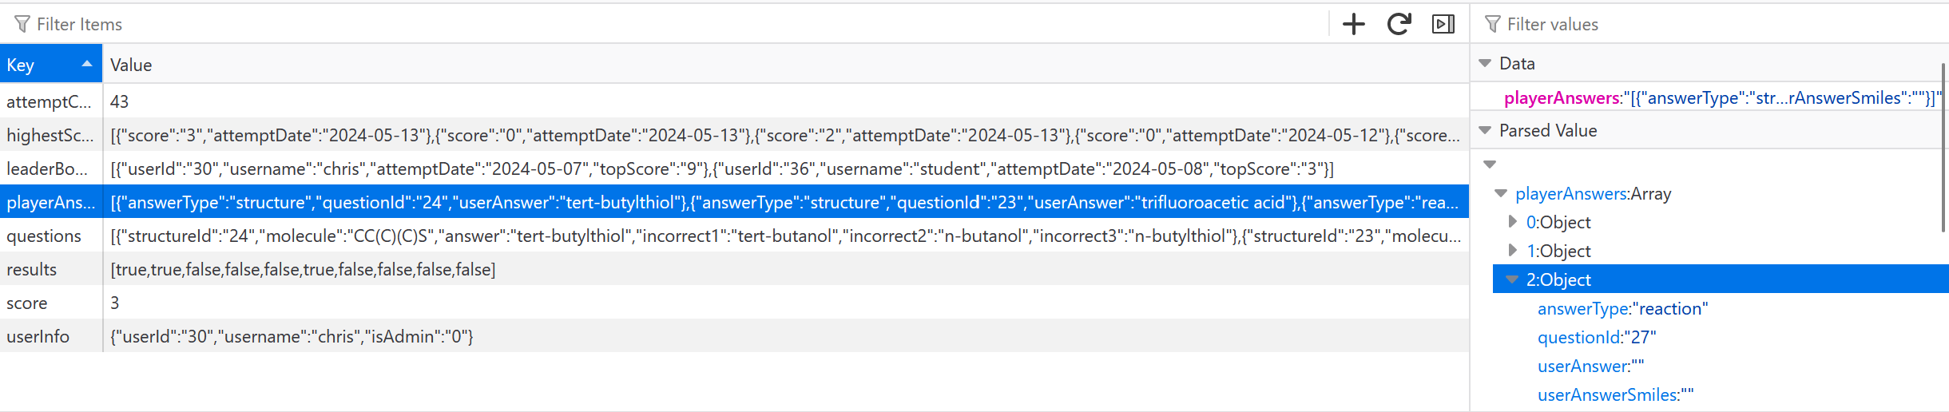
Technical Contributions and Functionalities Implemented
Return of the details to the question.js file
Now , once all these details are calculated , the php file returns these details as an array of objects
The questions.js stores the details in the session storage of the browser.

Slide 13
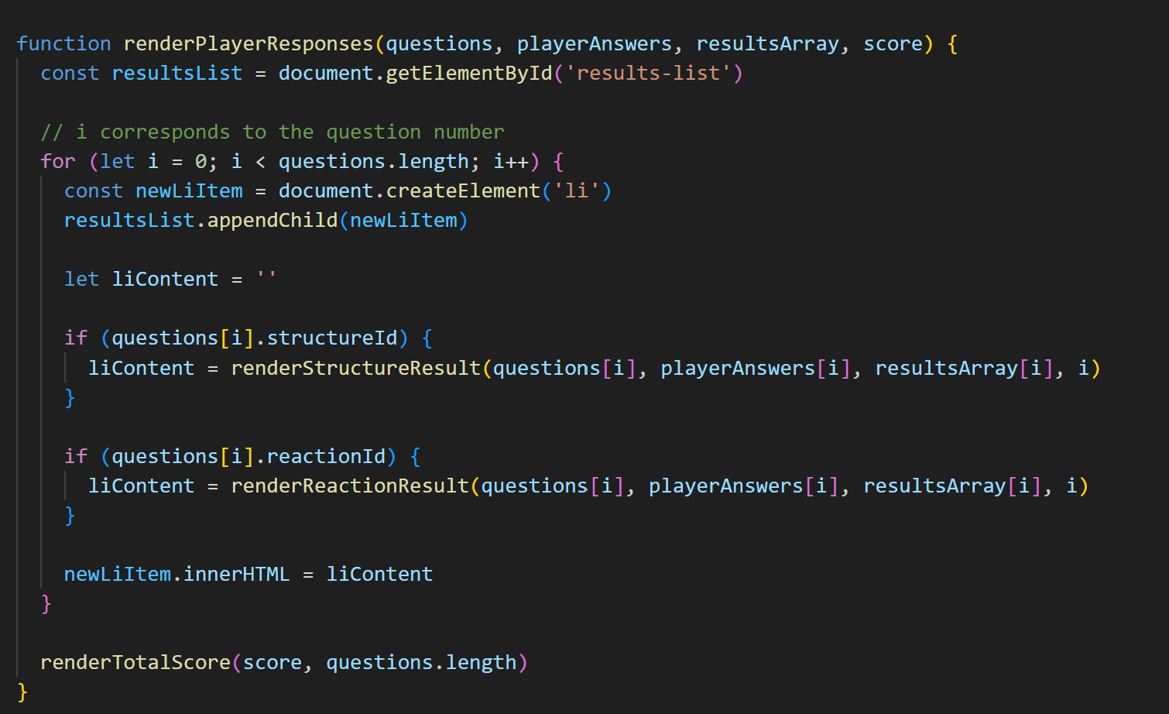
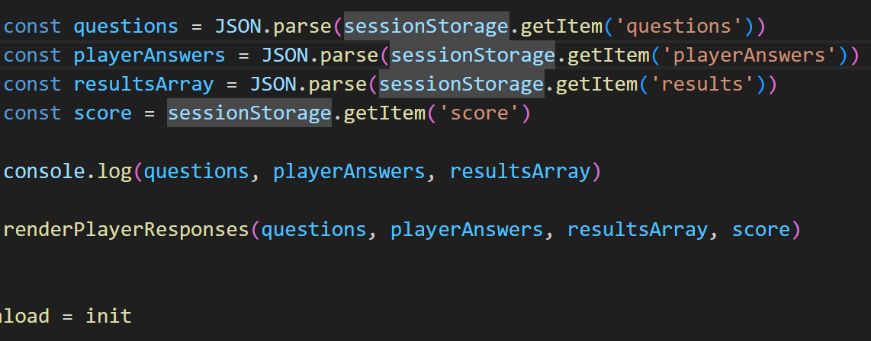
Technical Contributions and Functionalities Implemented
Rendering of the results on the Results page
The results.js picks up the data stored in the session storage, parses it and invokes a renderPlayerResponses() function to render each question , the user’s answer and the correct answer one by one.

Slide 14
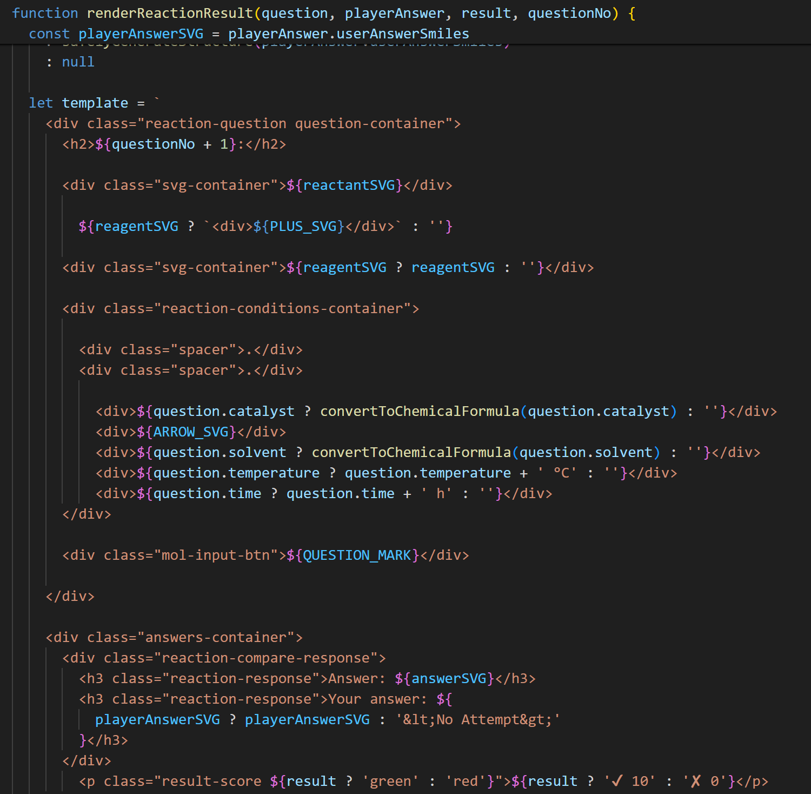
Technical Contributions and Functionalities Implemented
Rendering of the results on the Results page
The question type is checked whether it is a ‘structure’ based or ‘reaction’ based and a corresponding function is called , which makes use of an Rdkit to render the chemical structures on the screen as a ‘HTML template string’.

Slide 15
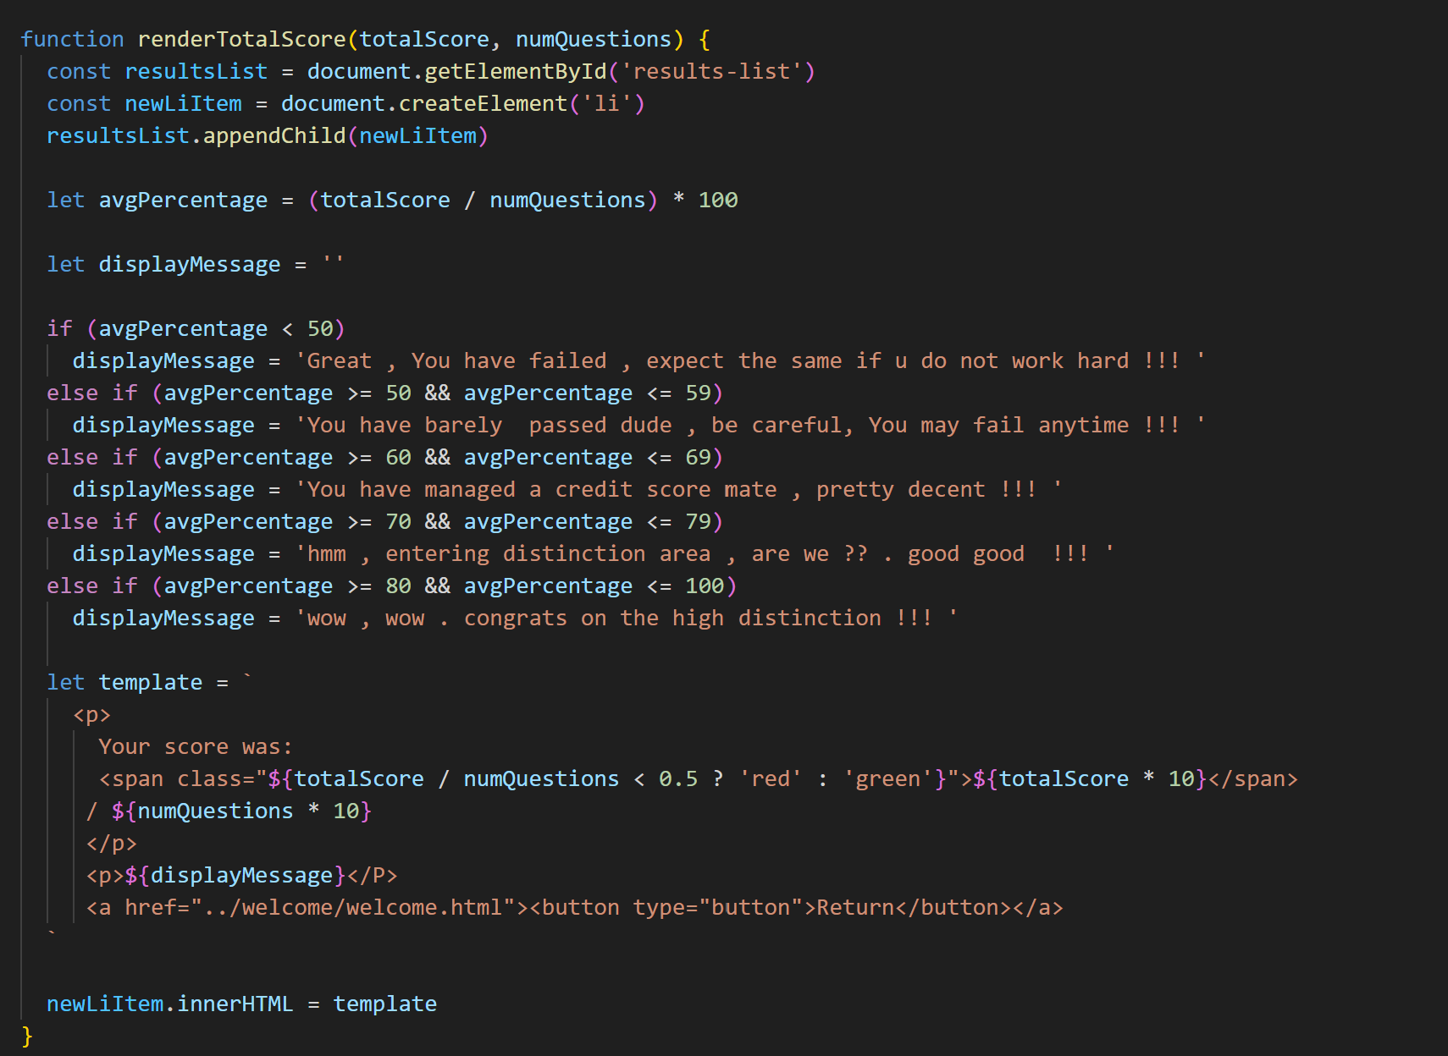
Technical Contributions and Functionalities Implemented
Display of Student Score and a custom message based on the score achieved
Finally, a function is used the display the student score and a custom message is also is played based on the score percentage achieved.

Slide 16
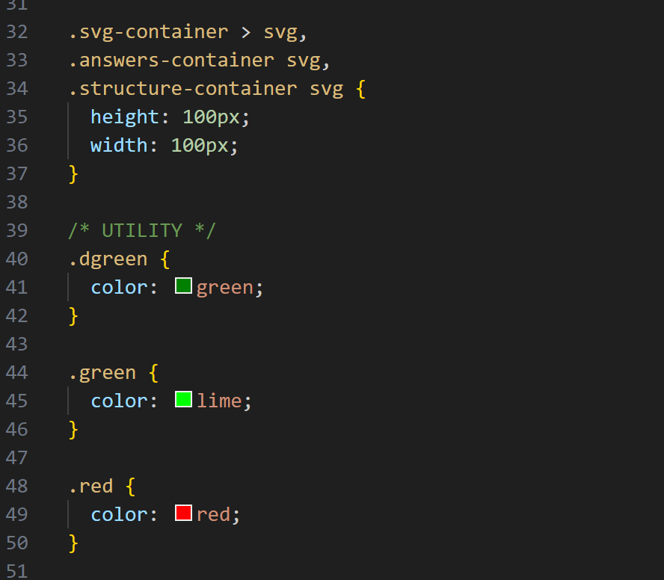
Technical Contributions and Functionalities Implemented
CSS page to design the results.html page
A CSS page has also been implemented to style the UI of the results page so that it offers a neat and immersive usage experience

Slide 17
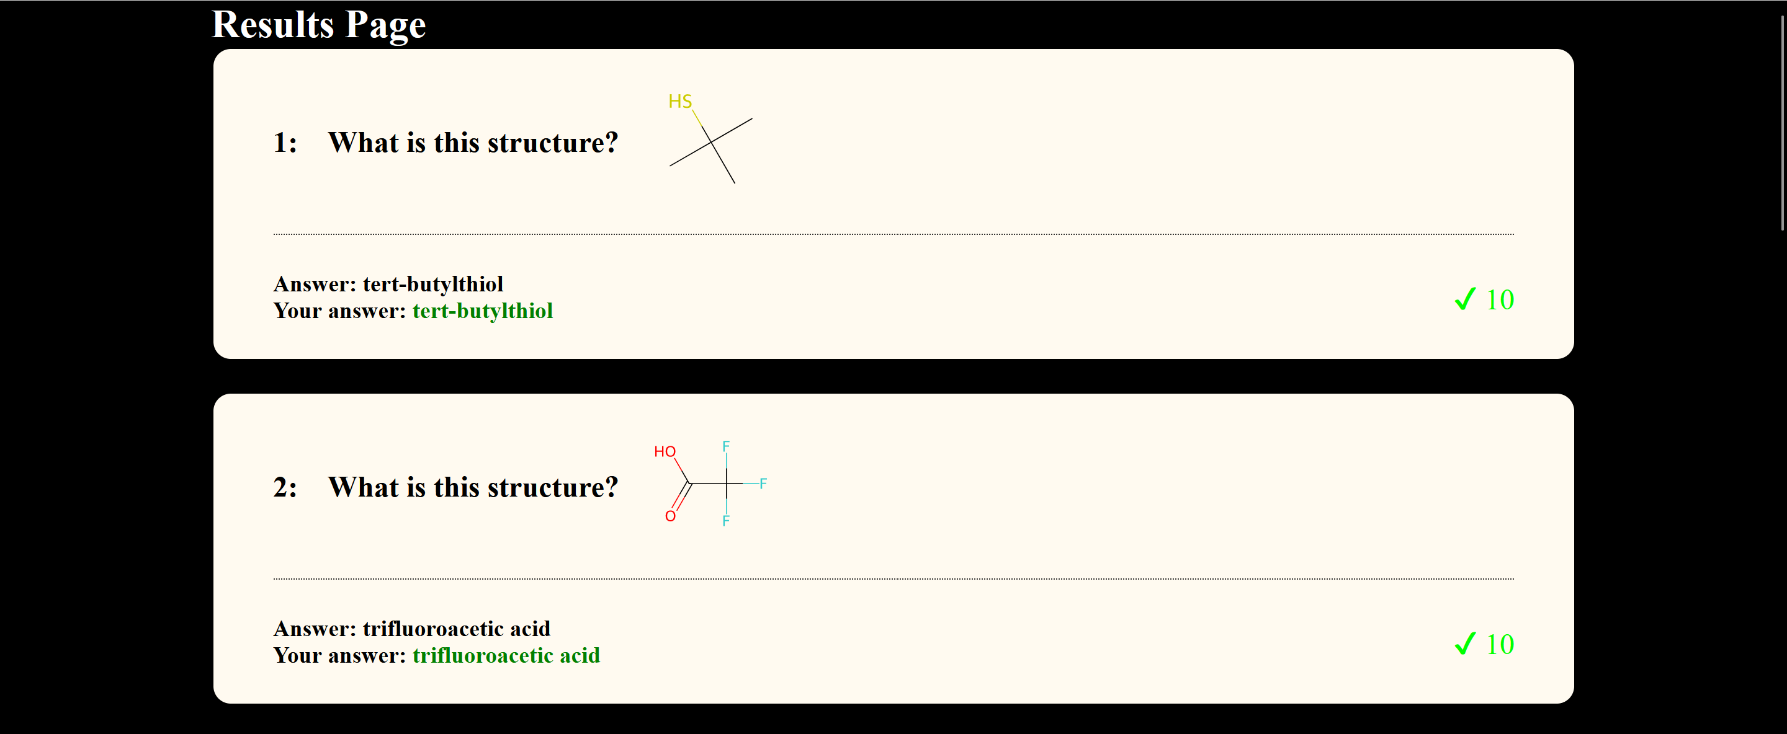
Technical Contributions and Functionalities Implemented
Final Output of results page

Slide 18
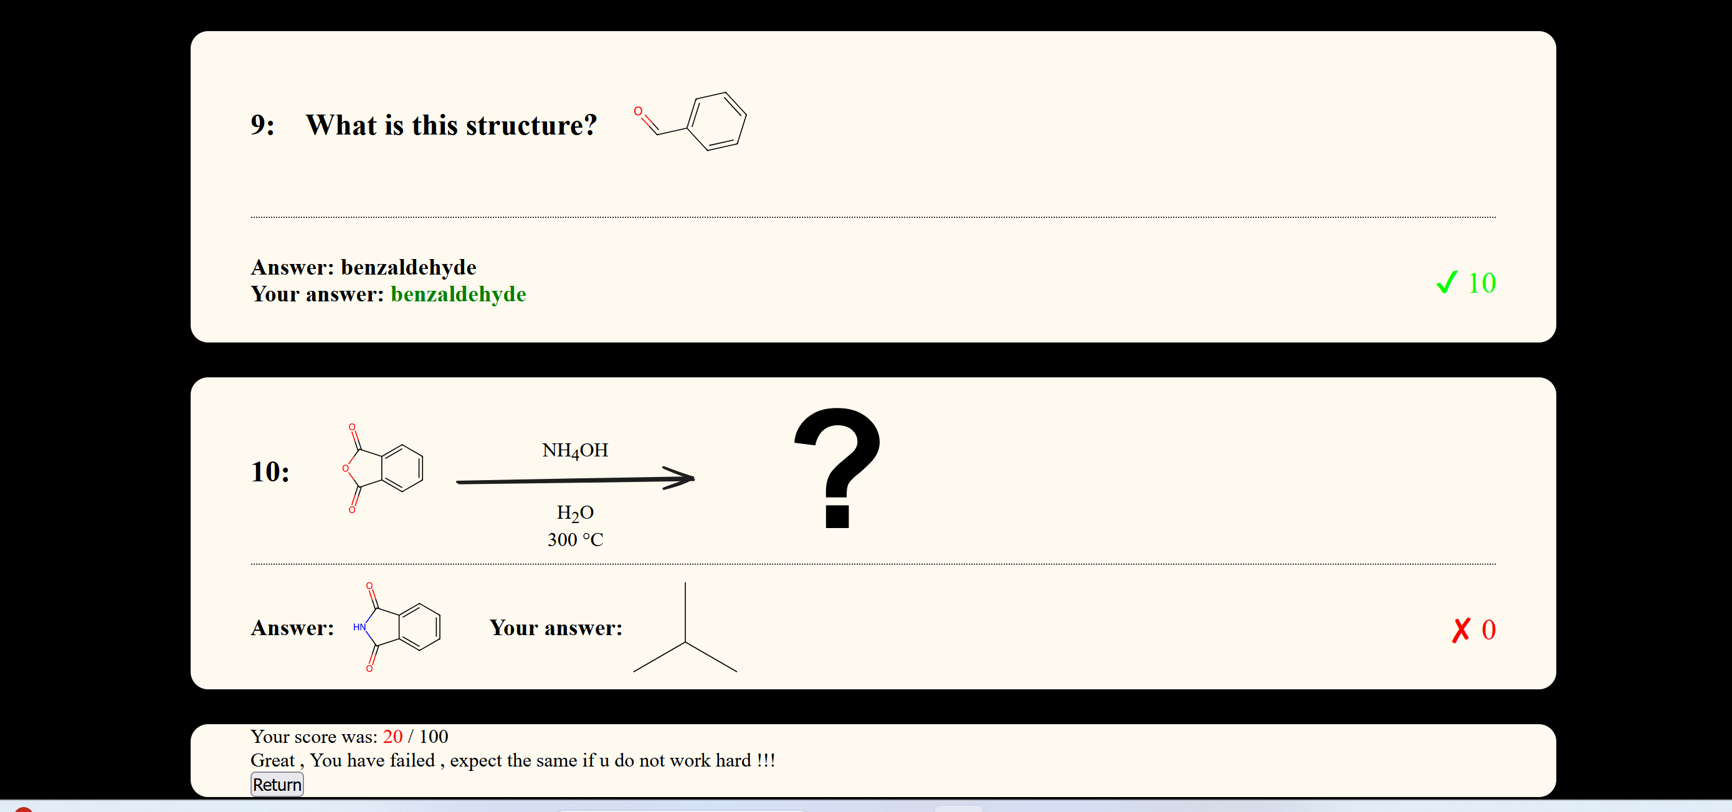
Technical Contributions and Functionalities Implemented

Slide 19
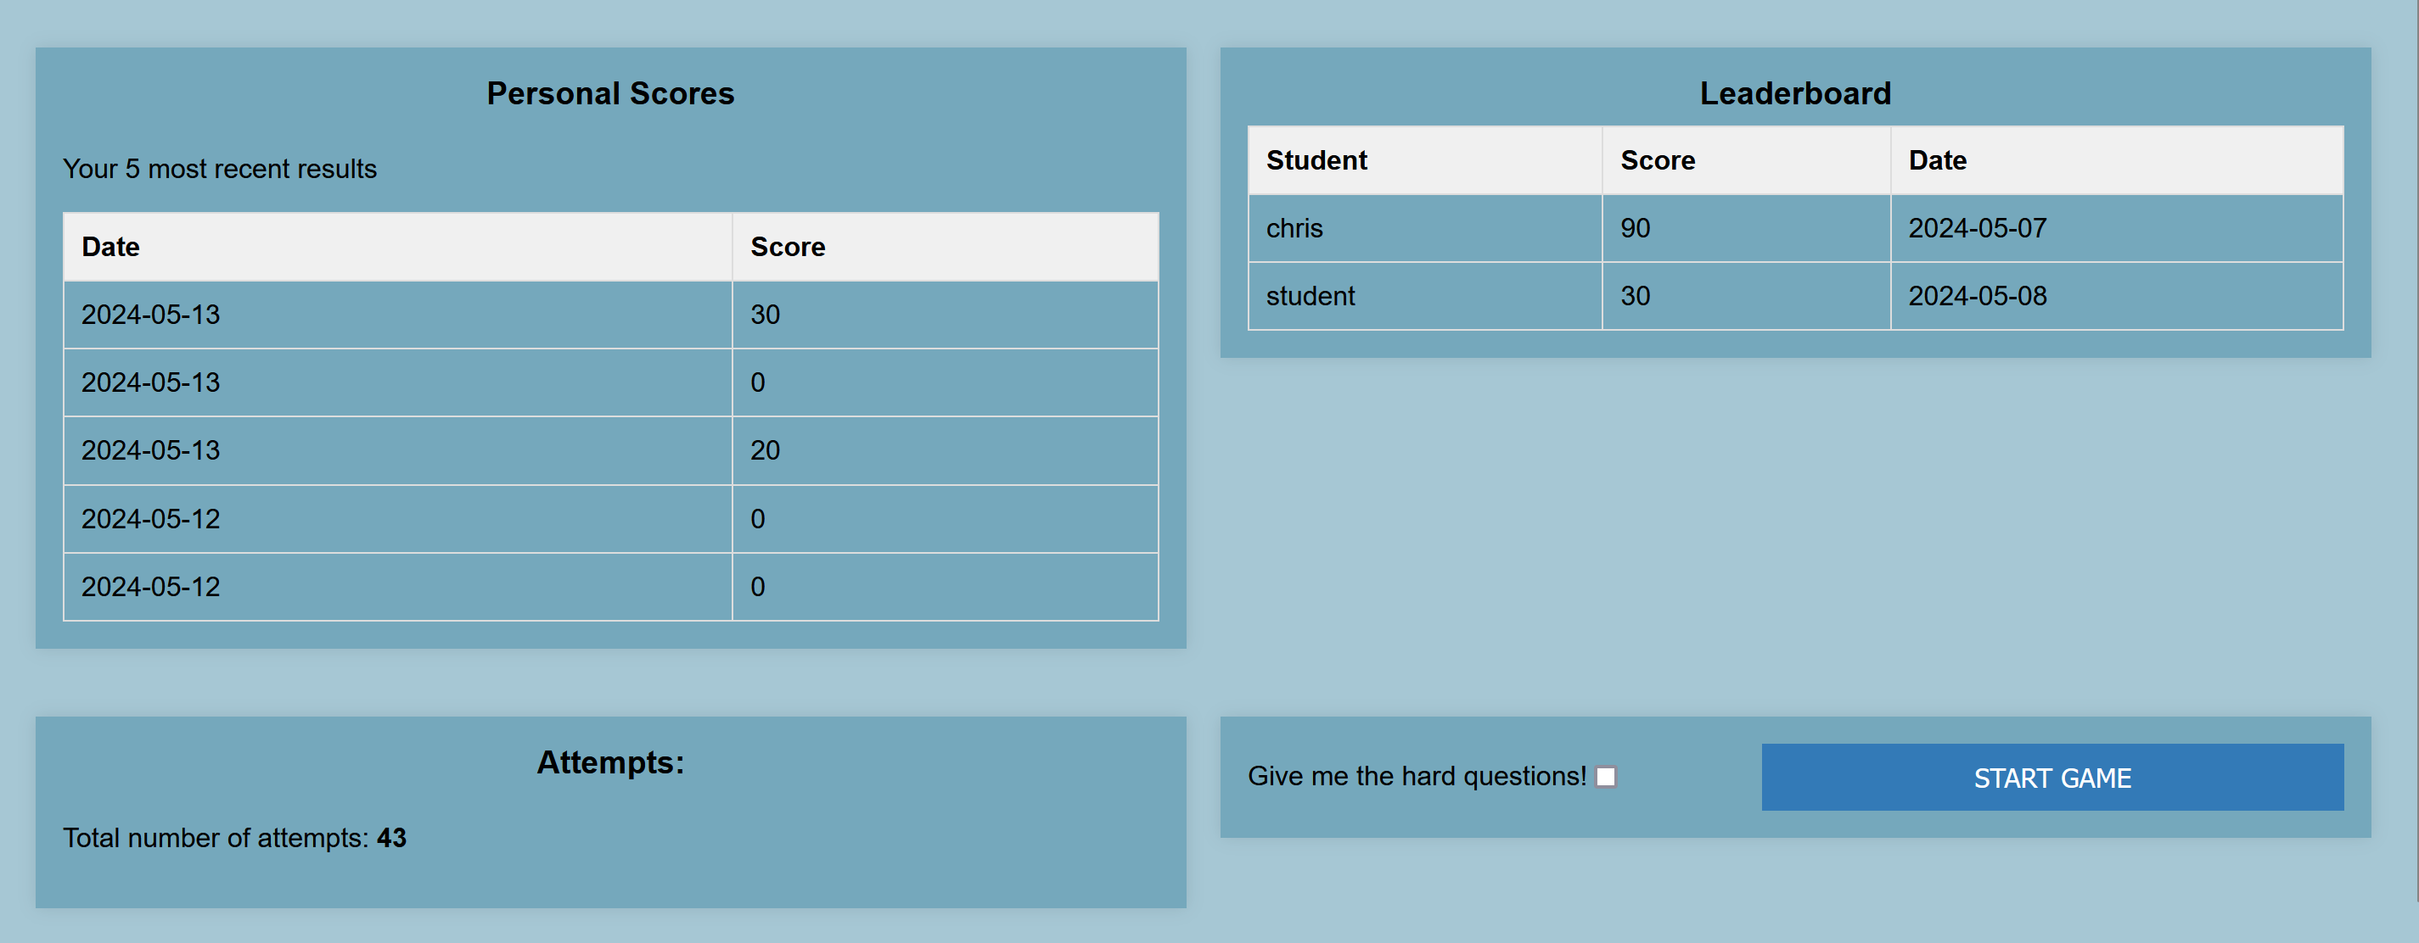
Technical Contributions and Functionalities Implemented

